Slide 1
Impact of bike usage patterns in maximizing annual membership
August 18, 2022
Presented by: Rupika Gopinathan

Slide 2
Goals for discussion
1. An overview of
total number
of riders
2. Identify the seasonal trending riders
3. Focus on the average ride duration by both user types
4. Discuss any potential areas for further exploration
Total number of user types weekly and monthly
Can help in interpreting the types of riders
We will discuss which type of user tend to use bike for long distances and what that means to your business goal
While there are many different next steps, we want to focus on the ones that are most important for your business.

Slide 3
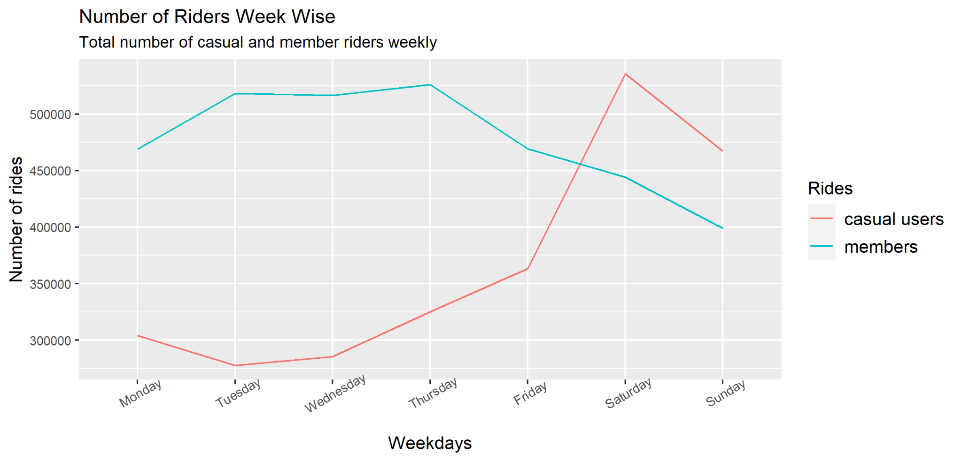
The casual users show a steep rise over the weekends
Data Overview
Our data is limited to Chicago
These are the observations from the past 13 months(July 2021 - July 2022)
As per data ethics, all PII has been anonymized, thus unique users aren’t filtered

Slide 4
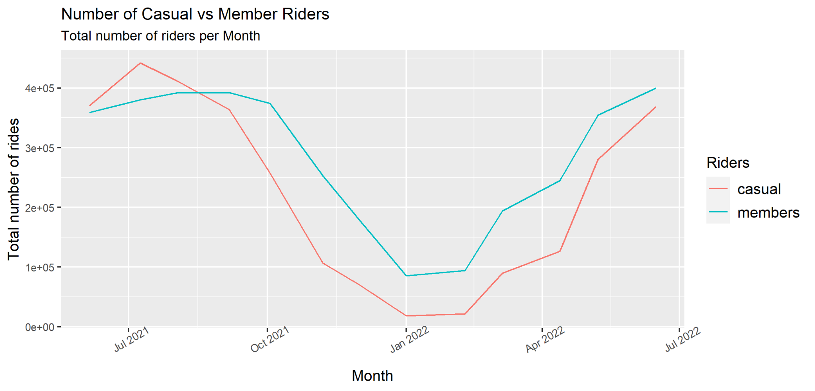
Summer experience the most number of
casual riders
Key takeaways
Consistent seasonal trend over a year
End of October to April historically experience less number of casual users
June to August experience the most number of casual users, most likely due to the summer festival
Number of member riders are fairly more than casual riders throughout the year, except for the summer season.
Notes:
So we can also theorize that most of the casual riders could be visitors who come for sightseeing or tourism during the summers.
Likewise, the season make them comfortable to use bikes as must not be the case during winters owing to the extreme temperature.

Slide 5
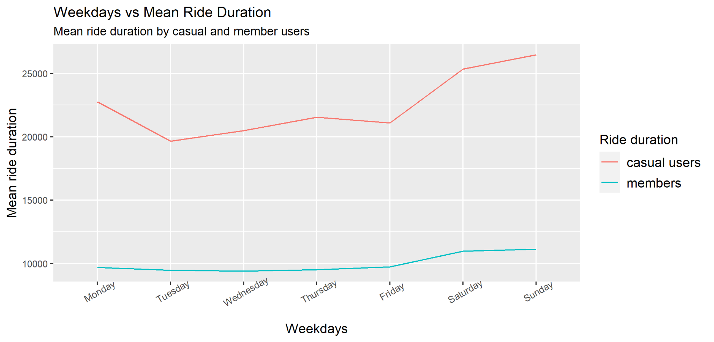
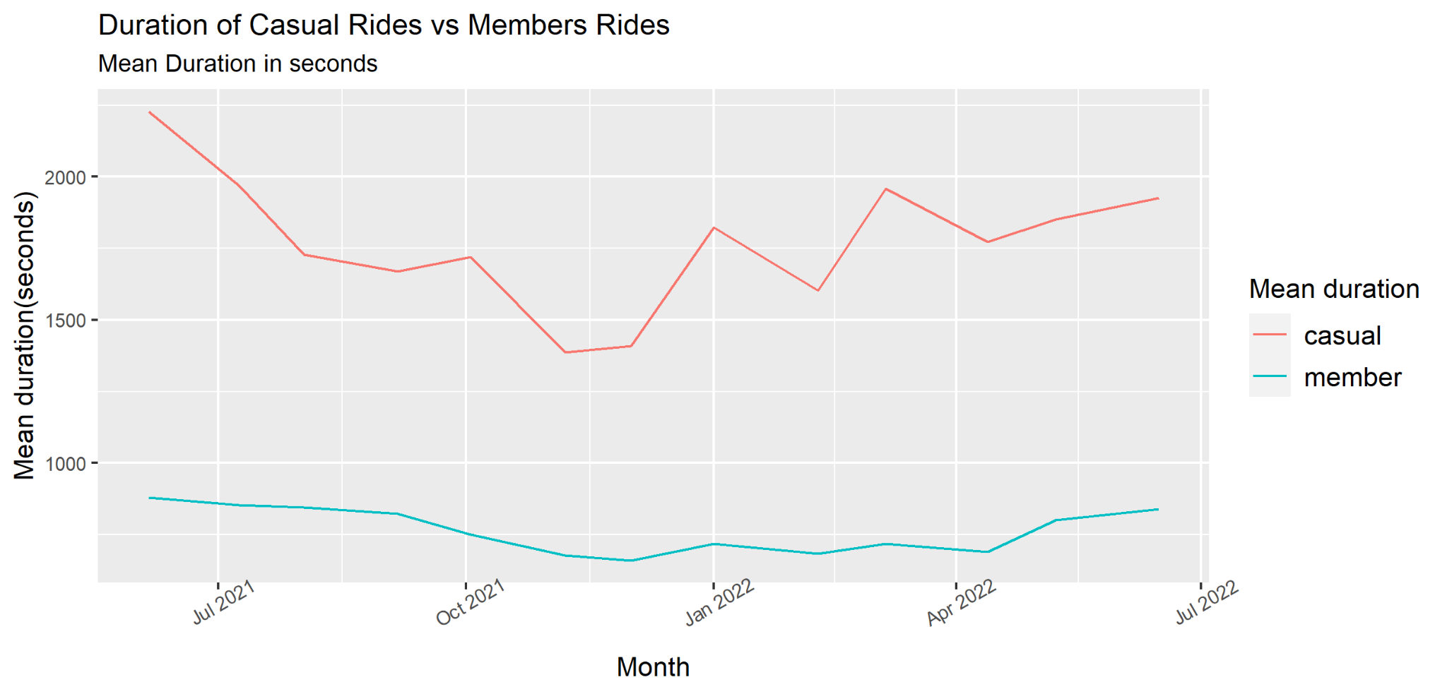
Casual users ride longer duration
Key takeaways
Irrespective of any factors, casual riders use bike for considerably longer duration than member riders
With the longest duration being rode from June through August and over the weekends
There is an overall reduction in riding distances by both casual and member users from October through April, with least riders during Winter.
Notes:
Most likely, the member riders use bikes going to and coming from work or school. As, during the weekdays, the ride duration show a consistent pattern, varying a small degree only during the weekends.

Slide 6
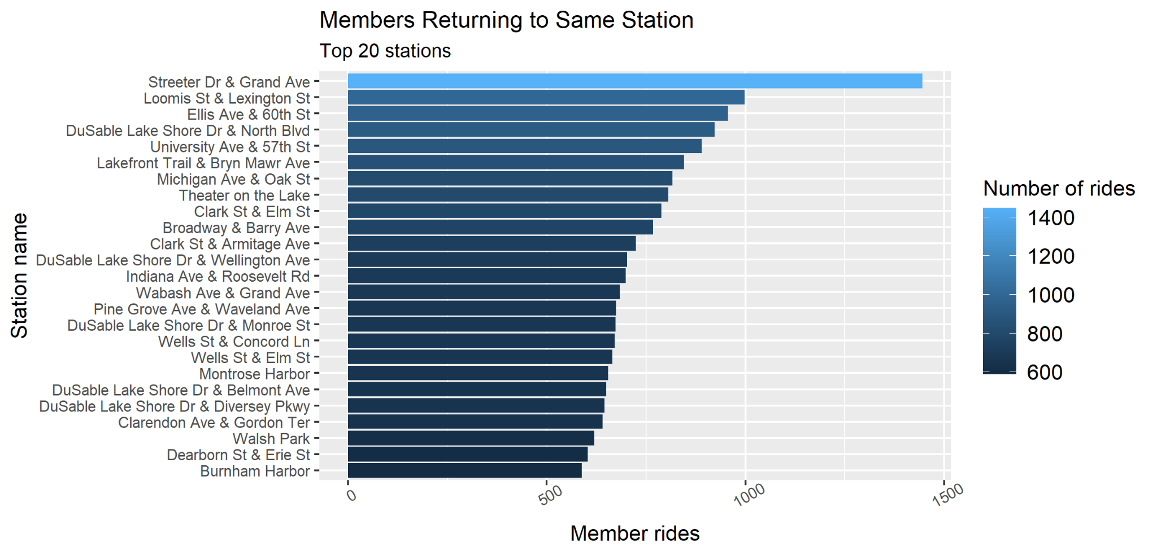
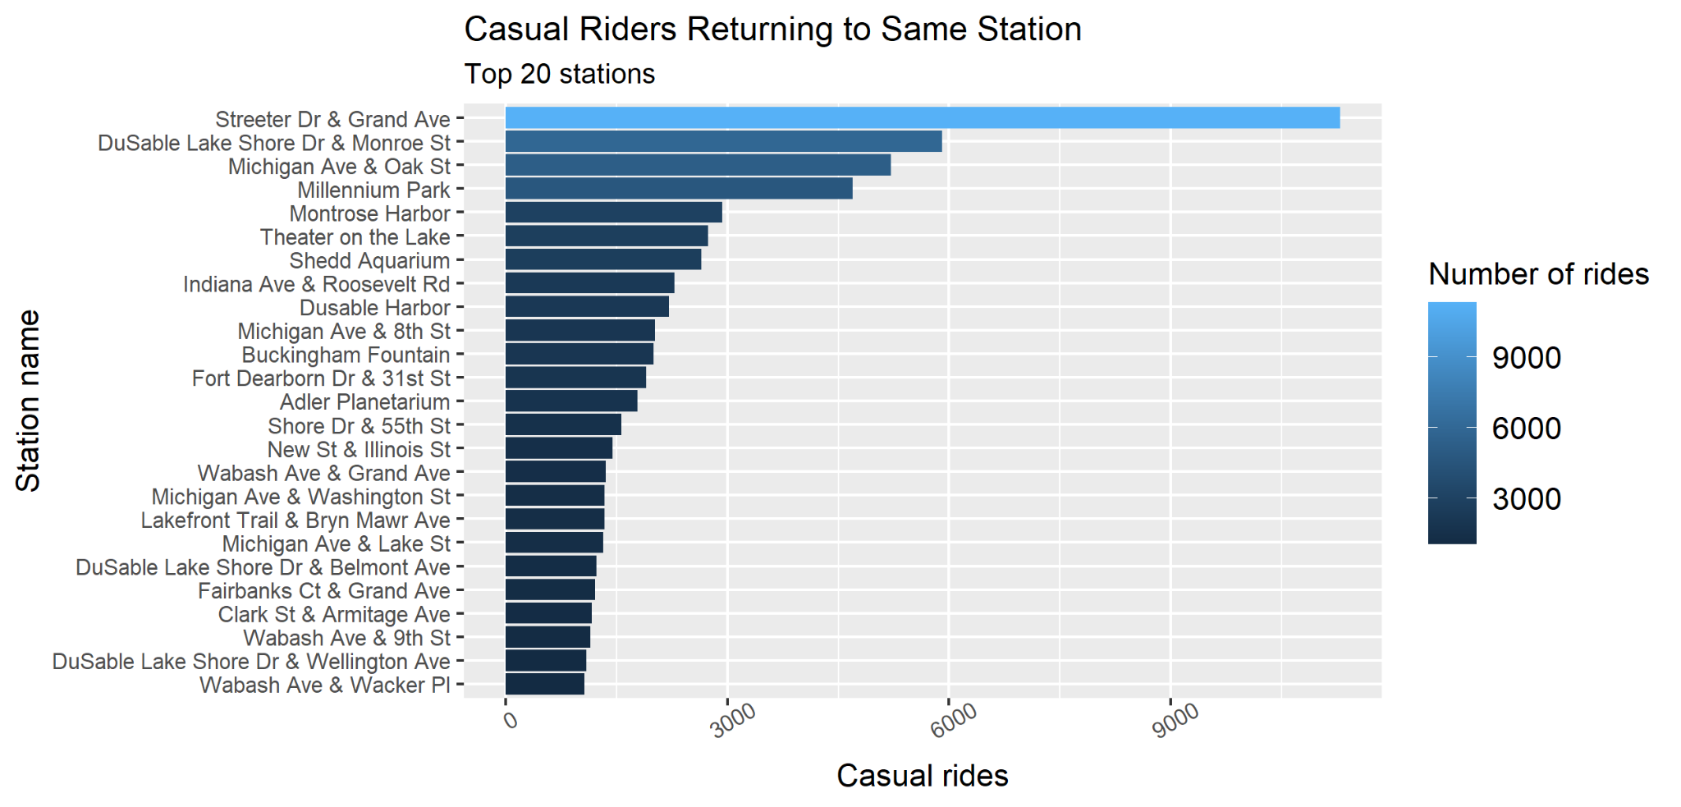
Maximum casual users visit the most popular station for leisure, located at the heart of Chicago
Summer is the most favorite time of the year to visit Chicago due to the Summer street festival, and numerous other fun activities (some for free).
The Streeter Dr station being the most accessible to the fun reach places, also the place is quite smooth and pleasant for bike riders.
Link for ref:
https://www.meganstarr.com/chicago-in-summer
Notes:
While, the members return the bikes to the same station, casual riders very likely use bike for fun activities.
People who are members seem to be permanently located at a place, thus, returning to the same station often than casual riders who must be trippers.

Slide 7
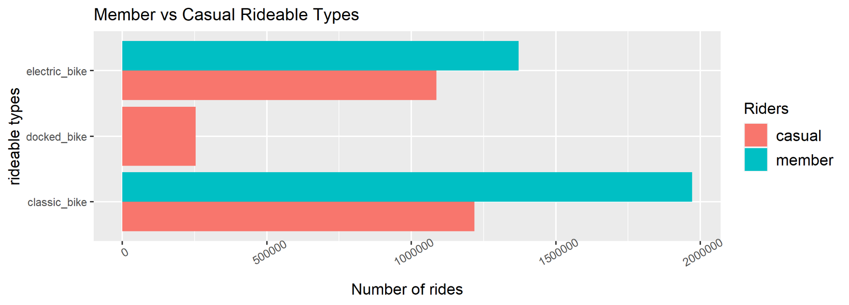
Classic bike is the most famous bike-type among users
Data limitation:
No record of docked bikes for members.

Slide 8
Conclusion
The trends suggest that most of the casual riders are visitors as there tend to be an increase in number of casual riders from July to August (during the Summer festive season), as well as through weekends all year.
On the other hand, the increased number of member rides round the year does not clearly states that the number of members are more than casual riders, as these rides can be taken by the same user multiple times.
Classic bike appears to be the most favorable rideable-type by both the user types. However, among the casual riders the difference in electric bike and classic bike usage is fairly at odds.

Slide 9
What should your company start to do after seeing these trends?
Multiple membership plans: Providing users with several choices could attract more visitors in signing up for membership.
Focus on ride length/duration: Special membership perks for riding at least 30 minutes in a day; as the least ride duration by casual users are around 32 mins.
Advertising: The top three most visited stations by casual users can be used for maximum advertisements and pitch-ins, such as posters, sales person pitch-ins, or an advertisement on a TV.
Classic bike: The most preferred among the rideable types is Classic and Electric bike. Increase the number of these bikes at the listed top 20 stations, offering a special membership plan.

Slide 10
Limitations
Data-privacy issues prohibit from using riders’ personally identifiable information. This means that one won’t be able to connect pass purchases to credit card numbers to determine if casual riders live in the bike-share service area or if they have purchased multiple single passes.

Slide 11

Questions

Slide 12

Thank You!

